Slide 1
Design of Integrated Micro-robotic Fish
Presentation 7
Yihua Liu
ayka_tsuzuki@sjtu.edu.cn
April 6, 2021

Slide 2
Improvement of COMSOL Model
von Mises stress (or equivalent tensile stress) is determined by the maximum distortion criterion (also von Mises yield criterion). It is a scalar value of stress that can be computed from the Cauchy stress tensor. It is used to predict yielding of materials under complex loading from the results of uniaxial tensile tests.
Principal stresses are the three stresses normal to these principal planes (no normal shear stresses).
The maximal stress (in value) of the principal stresses is called the first principal stress.

Slide 3
Theoretical assumption
The force of fluid flow on a solid object in the flow consists of the pressure of the fluid flow (normal stress) and the viscous resistance in the direction of the velocity of the fluid flow on the fluid-solid interface (shear stress). Both of them are surface force. Here we ignore the body force: gravity.
The stress of the solid can be equivalent to the resultant force of fluid flow on the solid.

Slide 4
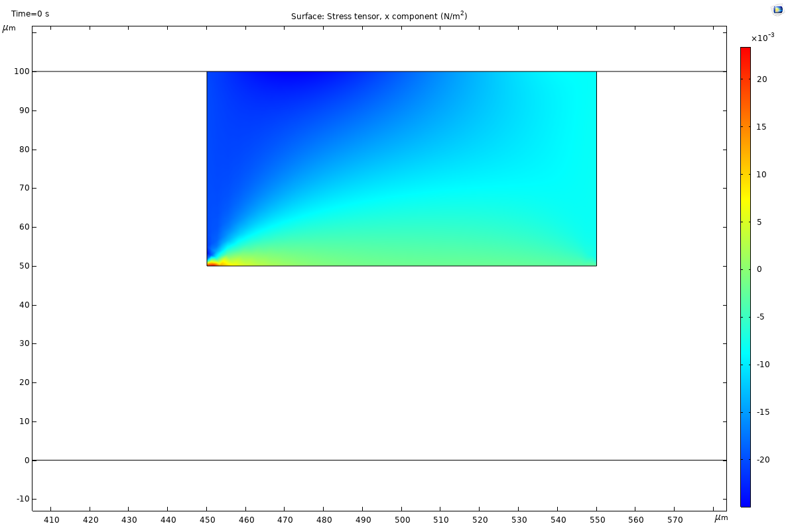
Therefore, we would like to find the stress in Model -> Component 1 (comp1) -> Solid Mechanics -> Stress -> Stress tensor (spatial frame) – N/m^2 -> solid.sx – Stress tensor, x component.
(Here we don’t need to use local coordinate system)

Slide 5
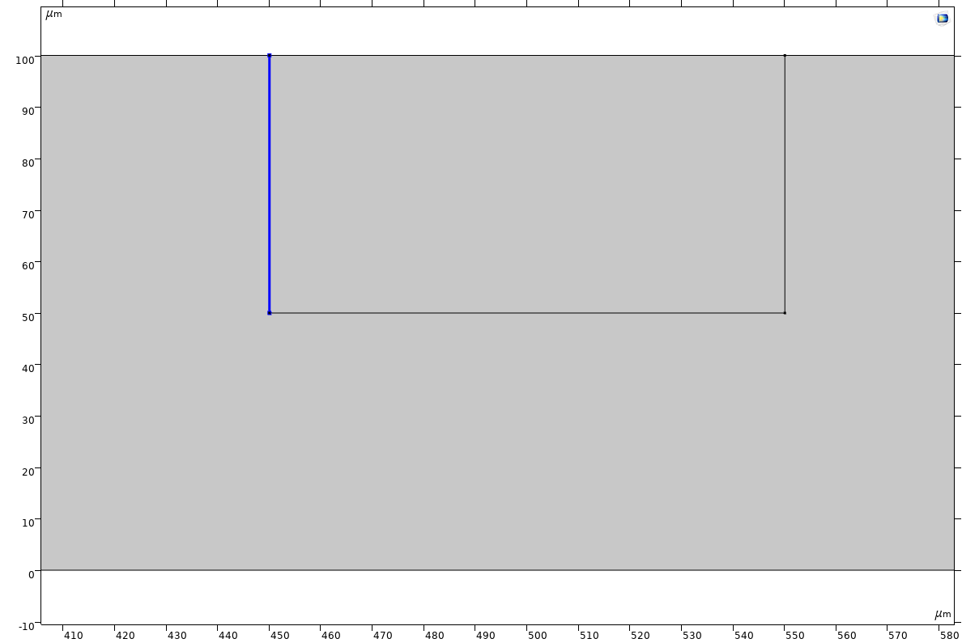
Using Derived Values: Line Integration 1 with Selection 4 and Expression solid.sx:

Slide 6
Export the Line Integration result in Table 1 – Line Integration 1:
Time (s) | Stress tensor, x component (N/m)
0 | -1.001995216103966E-6
0.005 | -4.001344863412647E-7
0.05 | -4.001337728505141E-7
0.5 | -4.0013377303283237E-7
1 | -4.001337729476293E-7
4 | -4.001337728677457E-7
Relatively VERY small value, so we use another way.

Slide 7
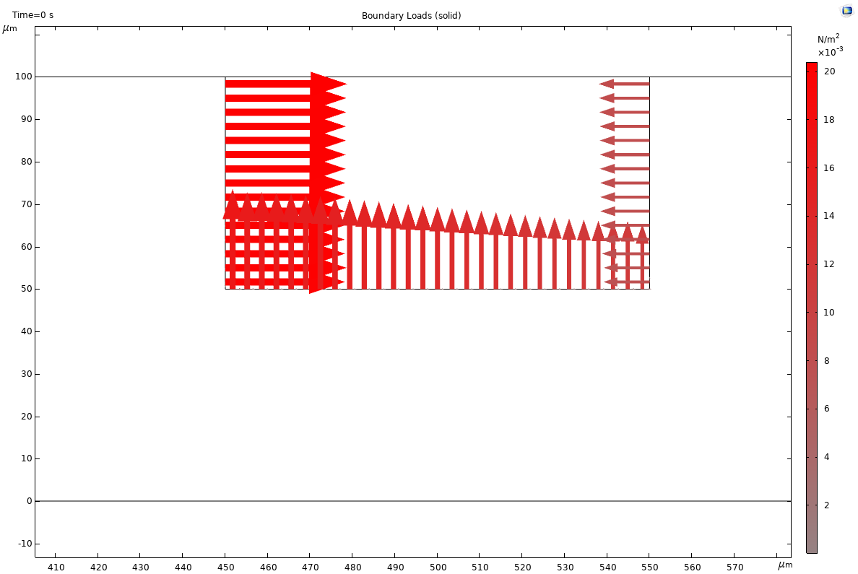
Applied Loads (solid): Tangential Load (fsi1.F_At_Mag) and Normal Load (fsi1.F_An_Mag) given by FSI

Slide 8
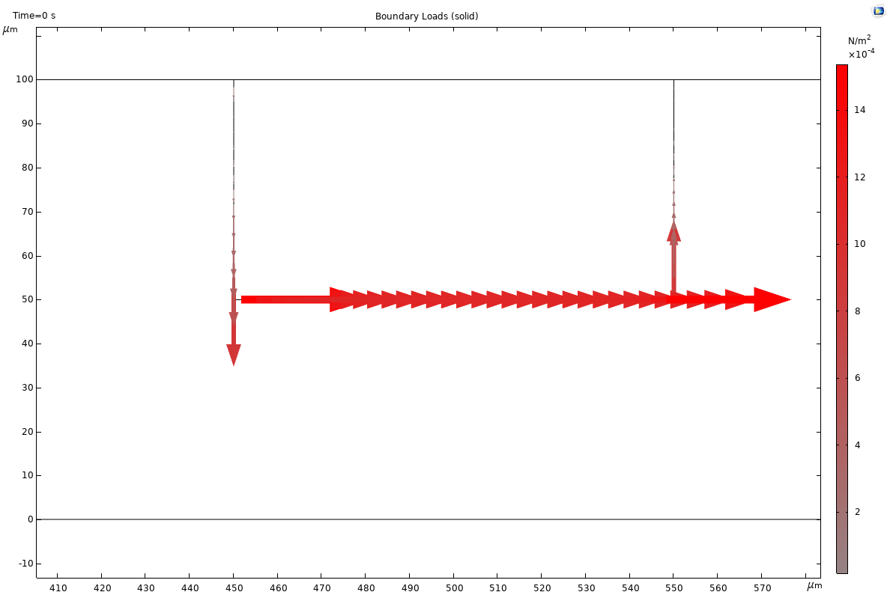
Tangential Load (fsi1.F_At_Mag)
% Model | Fluid-Solid-Interaction-2D.mph
% Version | COMSOL 5.6.0.280
% Date | Apr 6 2021, 13:50
% Dimension | 2
% Nodes | 59
% Expressions | 3
% Description | Arrow line
% x | y | VectorX | VectorY | Color
450.0000008 | 51.66666723 | -4.45E-10 | -9.05E-04 | 9.05E-04
450.0000021 | 55.00000137 | -1.83E-10 | -5.97E-04 | 5.97E-04
450.0000031 | 58.33333514 | -1.10E-10 | -4.47E-04 | 4.47E-04
450.0000038 | 61.66666881 | -7.72E-11 | -3.60E-04 | 3.60E-04
450.0000045 | 65.00000241 | -5.67E-11 | -2.97E-04 | 2.97E-04
450.0000051 | 68.33333597 | -4.20E-11 | -2.44E-04 | 2.44E-04
450.0000057 | 71.6666695 | -3.09E-11 | -1.98E-04 | 1.98E-04
450.0000062 | 75.00000301 | -2.21E-11 | -1.56E-04 | 1.56E-04
450.0000066 | 78.3333365 | -1.52E-11 | -1.18E-04 | 1.18E-04
450.000007 | 81.66666999 | -9.72E-12 | -8.17E-05 | 8.17E-05
450.0000074 | 85.00000347 | -5.61E-12 | -5.10E-05 | 5.10E-05
450.0000078 | 88.33333694 | -1.99E-12 | -1.93E-05 | 1.93E-05
450.0000081 | 91.66667042 | -1.65E-12 | -1.68E-05 | 1.68E-05
450.0000084 | 95.00000391 | 6.23E-12 | 6.50E-05 | 6.50E-05
450.0000087 | 98.33333739 | -1.37E-11 | -1.43E-04 | 1.43E-04
451.7241379 | 50 | 0.001537533 | 0 | 0.001537533
455.1724138 | 50 | 0.001294339 | 0 | 0.001294339
458.6206897 | 50 | 0.00119423 | 6.94E-18 | 0.00119423
462.0689655 | 50 | 0.001150566 | 6.94E-18 | 0.001150566
465.5172414 | 50 | 0.001127956 | 0 | 0.001127956

Slide 9
Normal Load (fsi1.F_An_Mag)
% Model | Fluid-Solid-Interaction-2D.mph
% Version | COMSOL 5.6.0.280
% Date | Apr 6 2021, 13:53
% Dimension | 2
% Nodes | 59
% Expressions | 3
% Description | Arrow line
% x | y | VectorX | VectorY | Color
450.0000008 | 51.66666723 | 0.020032881 | -9.85E-09 | 0.020032881
450.0000021 | 55.00000137 | 0.020282682 | -6.21E-09 | 0.020282682
450.0000031 | 58.33333514 | 0.020022246 | -4.94E-09 | 0.020022246
450.0000038 | 61.66666881 | 0.019961982 | -4.29E-09 | 0.019961982
450.0000045 | 65.00000241 | 0.019976231 | -3.82E-09 | 0.019976231
450.0000051 | 68.33333597 | 0.020012551 | -3.44E-09 | 0.020012551
450.0000057 | 71.6666695 | 0.020053385 | -3.12E-09 | 0.020053385
450.0000062 | 75.00000301 | 0.020092114 | -2.85E-09 | 0.020092114
450.0000066 | 78.3333365 | 0.020125445 | -2.61E-09 | 0.020125445
450.000007 | 81.66666999 | 0.02015177 | -2.40E-09 | 0.02015177
450.0000074 | 85.00000347 | 0.02016981 | -2.22E-09 | 0.02016981
450.0000078 | 88.33333694 | 0.020181939 | -2.08E-09 | 0.020181939
450.0000081 | 91.66667042 | 0.020190413 | -1.99E-09 | 0.020190413
450.0000084 | 95.00000391 | 0.020244833 | -1.94E-09 | 0.020244833
450.0000087 | 98.33333739 | 0.020396646 | -1.94E-09 | 0.020396646
451.7241379 | 50 | 0 | 0.01672158 | 0.01672158
455.1724138 | 50 | 0 | 0.016176383 | 0.016176383
458.6206897 | 50 | 0 | 0.016215875 | 0.016215875
462.0689655 | 50 | 0 | 0.016105465 | 0.016105465
465.5172414 | 50 | 0 | 0.015931347 | 0.015931347

Slide 10
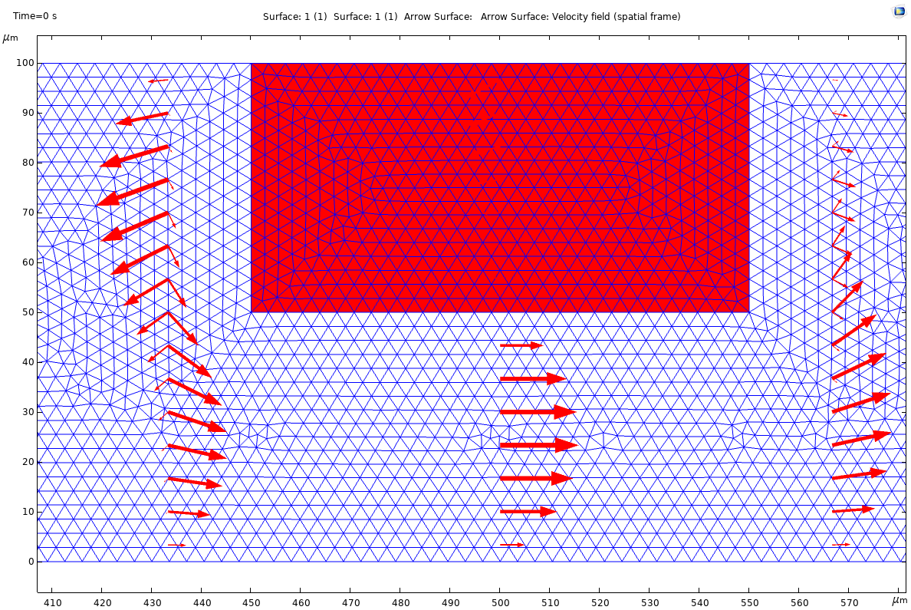
Deformed mesh and geometry

Slide 11
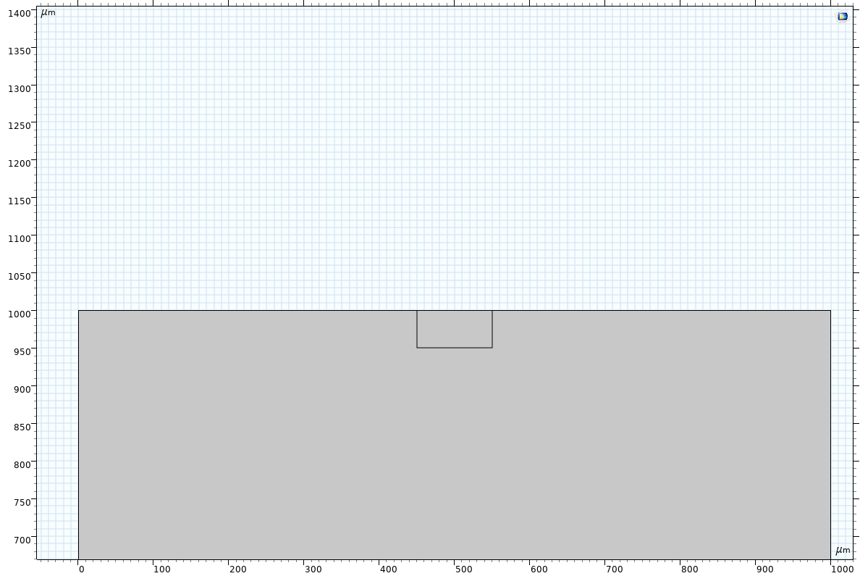
Giving a very large channel height H=1000[μm]

Slide 12
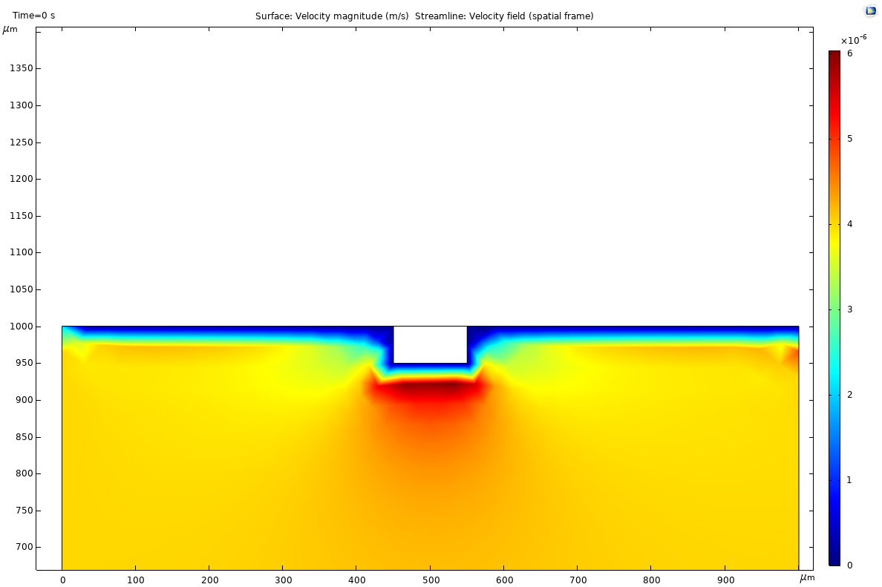

Slide 13
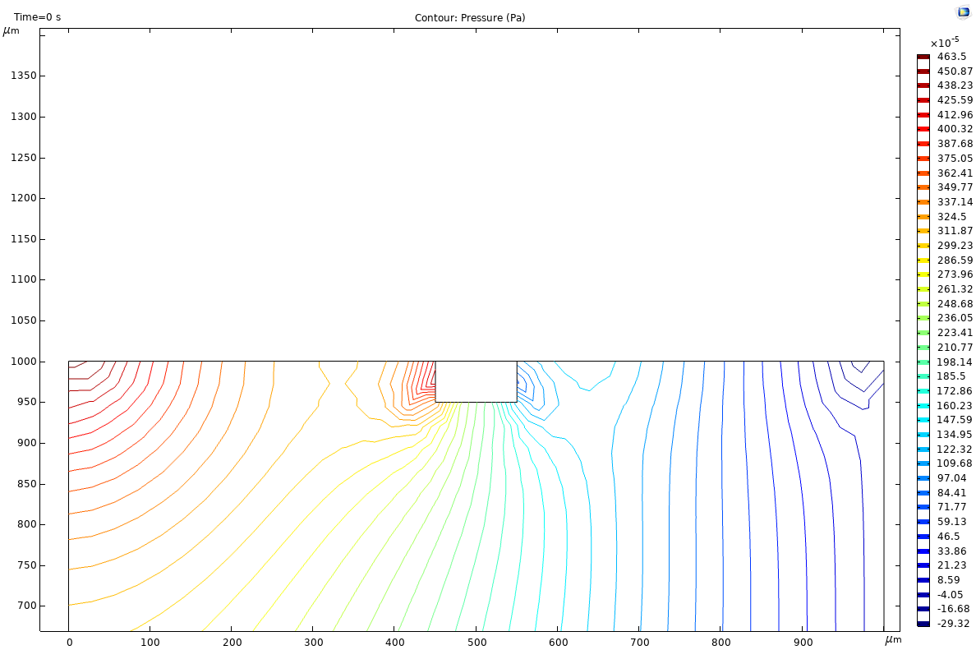

Slide 14
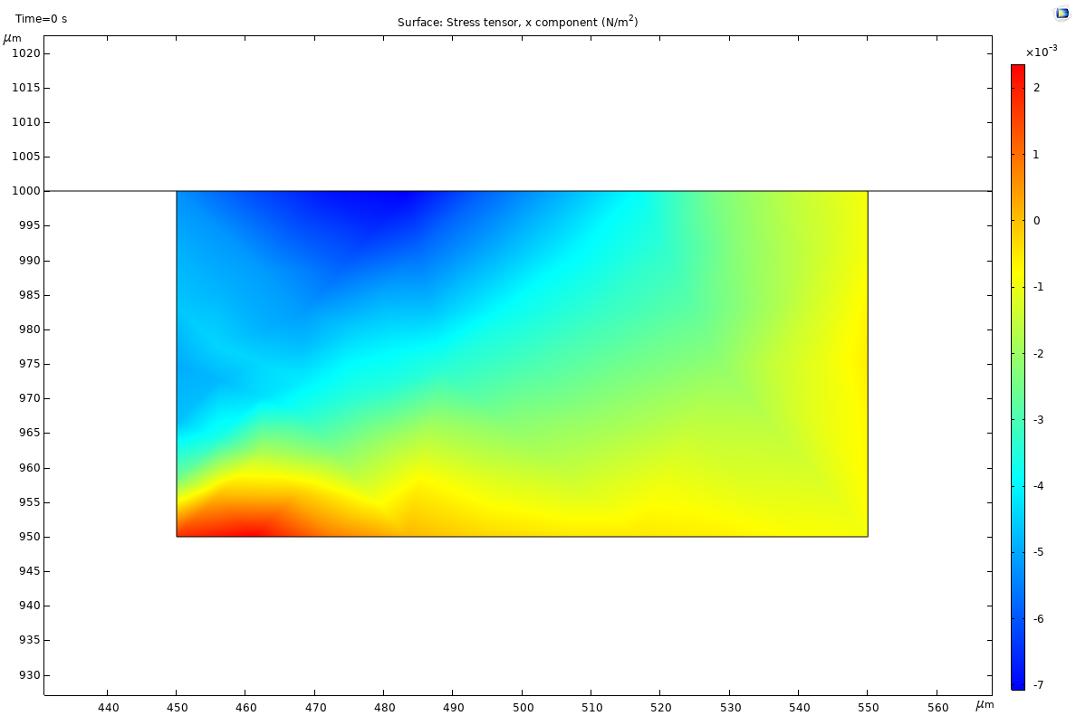

Slide 15
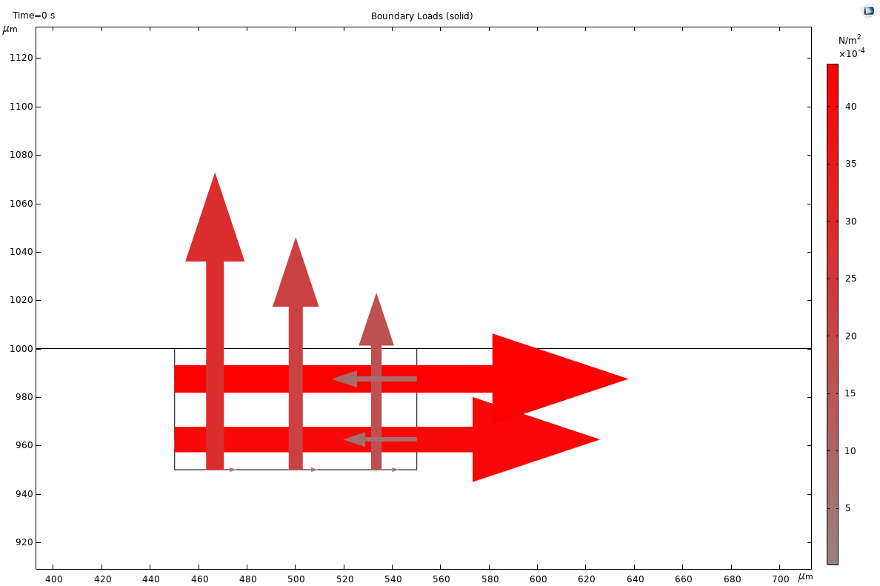

Slide 16
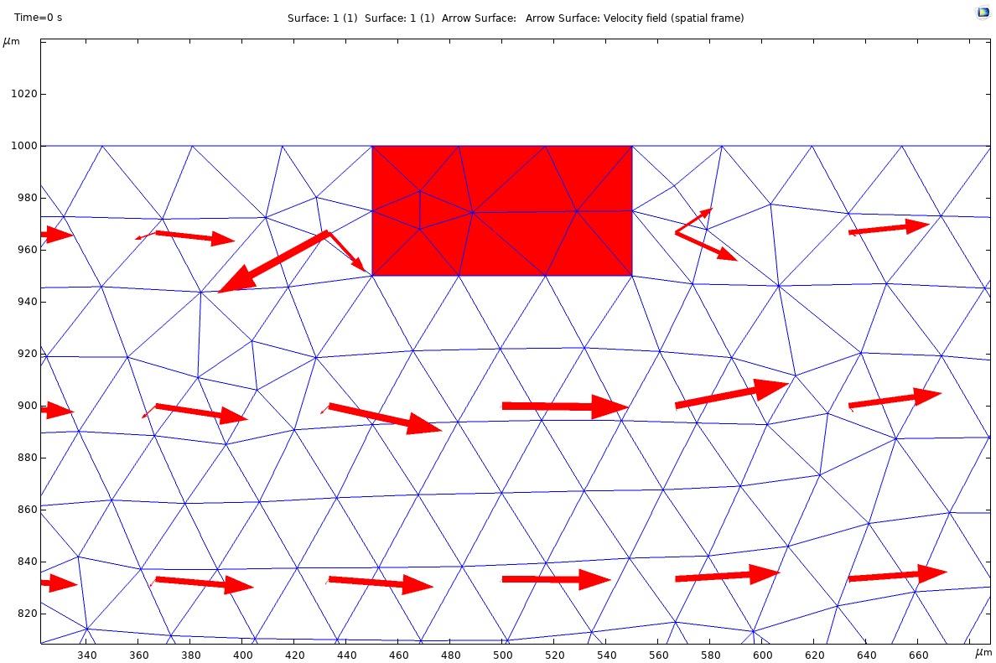

Slide 17
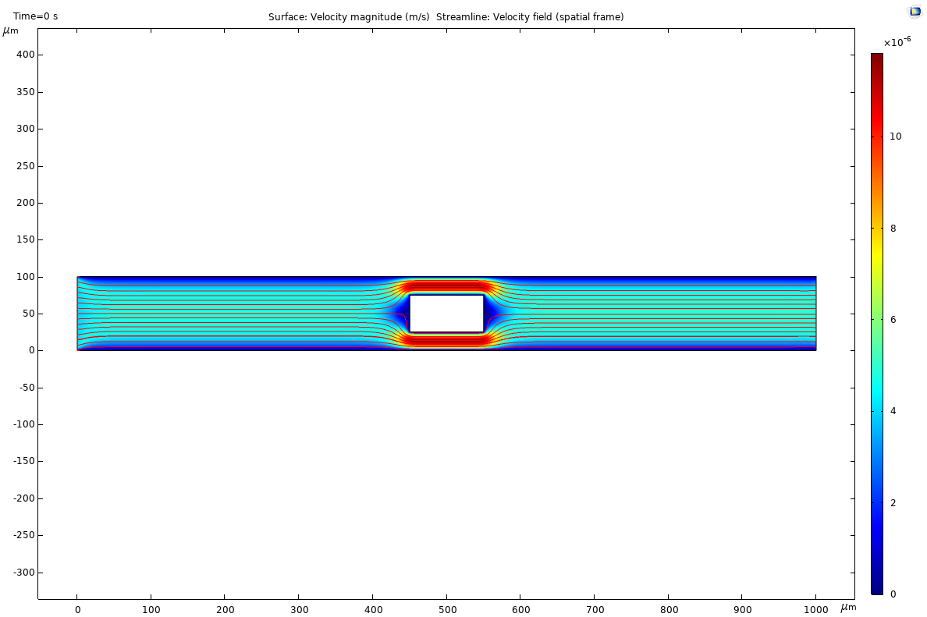
Put in the middle

Slide 18
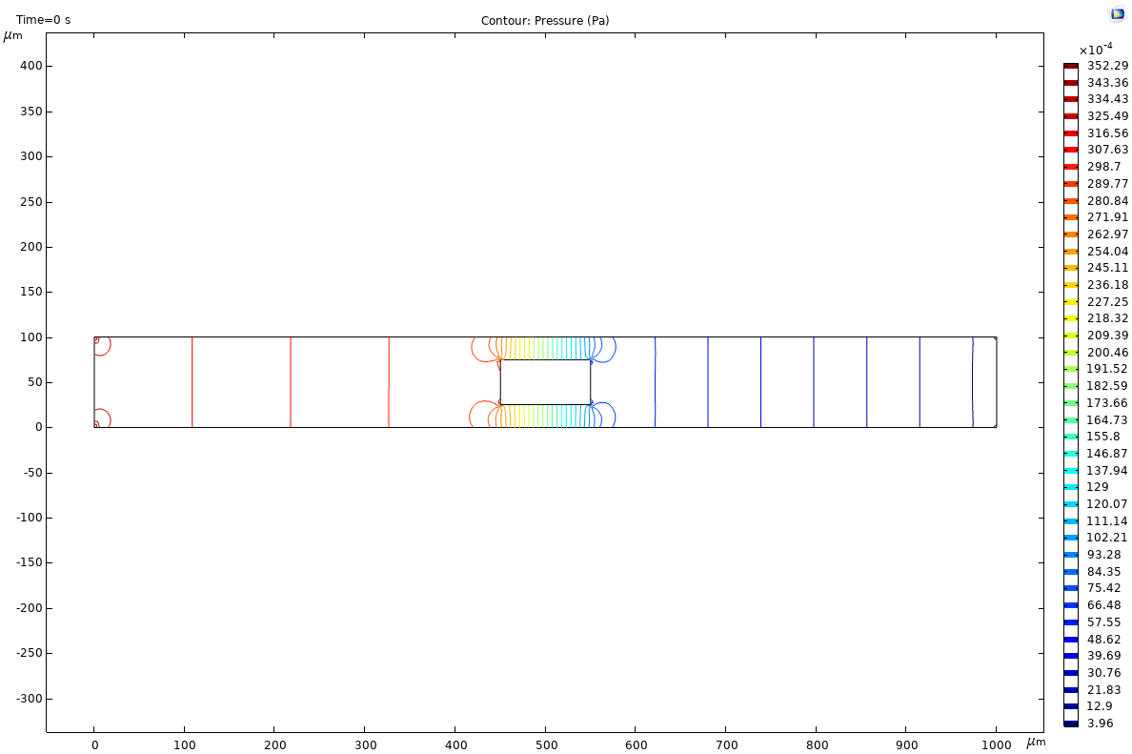

Slide 19
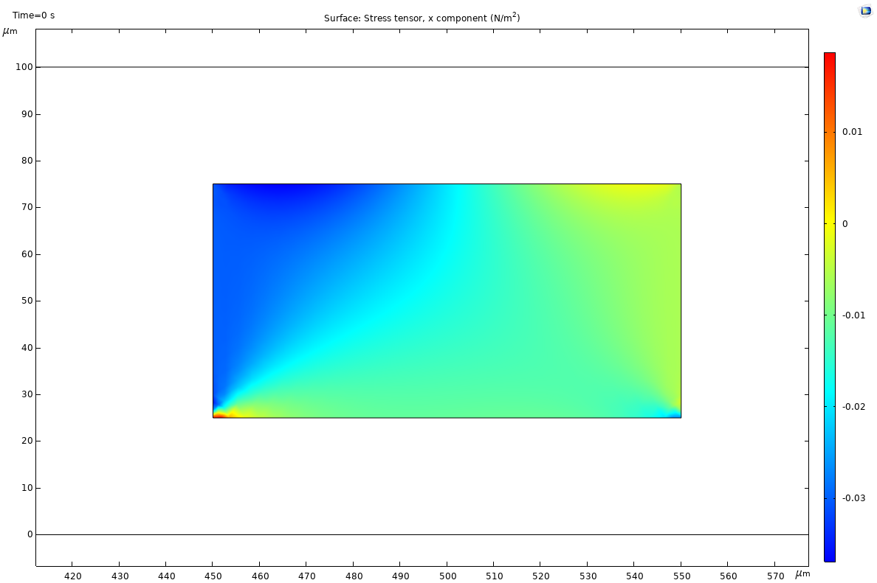

Slide 20
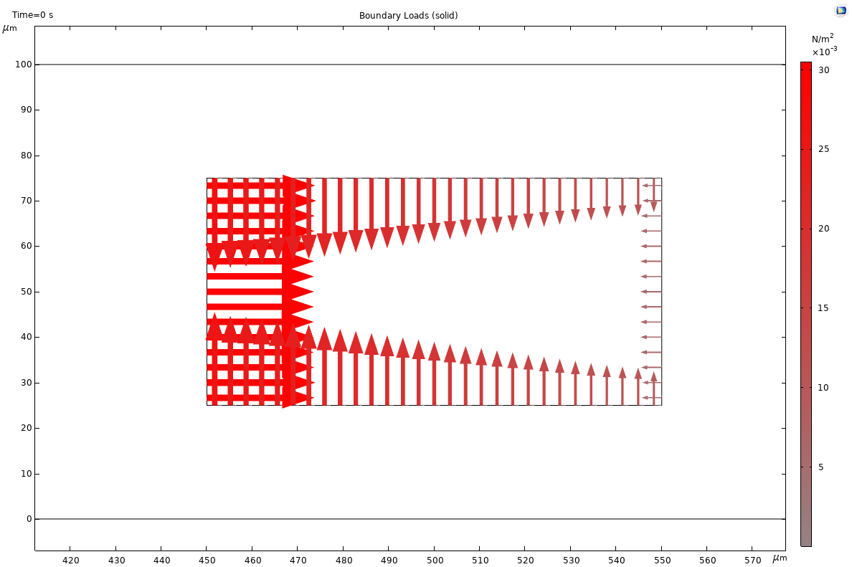

Slide 21
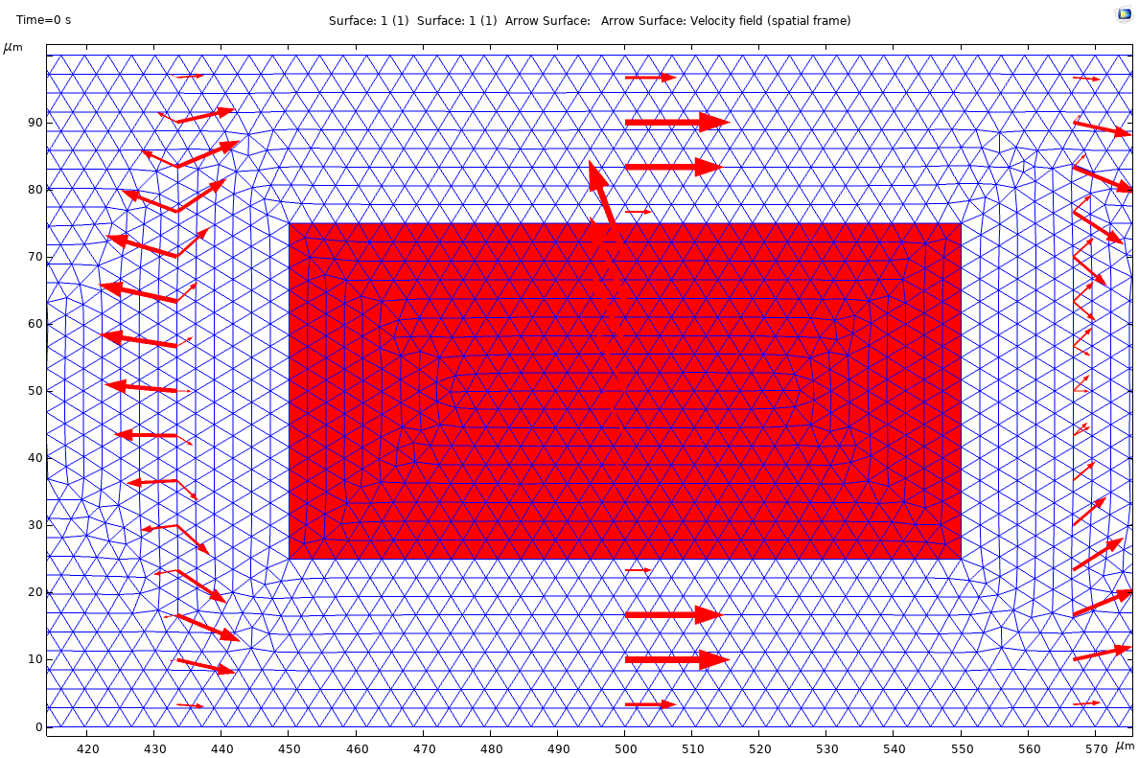

Slide 22
Question: the pressure is not uniform
Reason: The Inlet boundary condition of the laminar flow is set to be “Velocity”, and the velocity is set to “Normal inflow velocity” U0=U=0.004[mm/s]. Considering the viscosity, the pressure cannot be uniform.
However, we can define the normal flow velocity by
U0=u_mean*6*(H-Y)*Y/H^2 m/s, where u_mean=U is the Inlet mean velocity, H is the channel height, Y is the y-coordinate.
Question: the stress when the solid in the middle is not symmetric

Slide 23
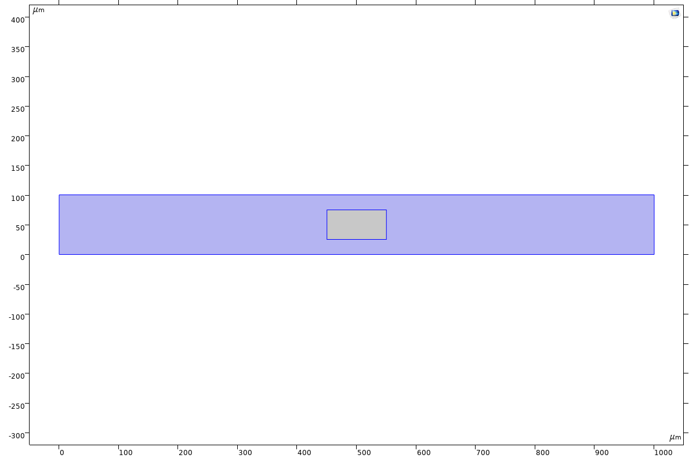
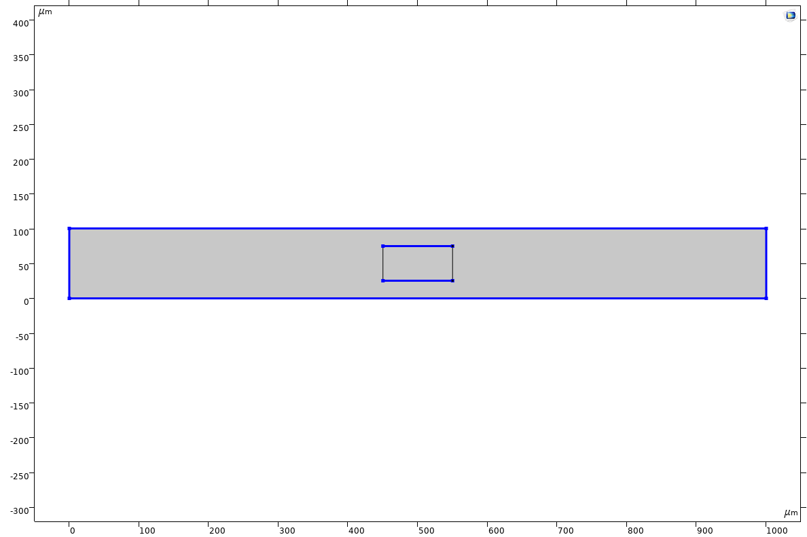
The reason that though the solid is applied with considerable load but not moving because our definitions of moving mesh does not include it:
Deforming Domain 1
Fixed Boundary 1

Slide 24
Thanks!

